Slide 1
The Period Movement
By Kaitlyn Freeman, MaryKate Mello, Emalisa Depina, Jacqueline Molina, & Jacqueline Mejia

Slide 2
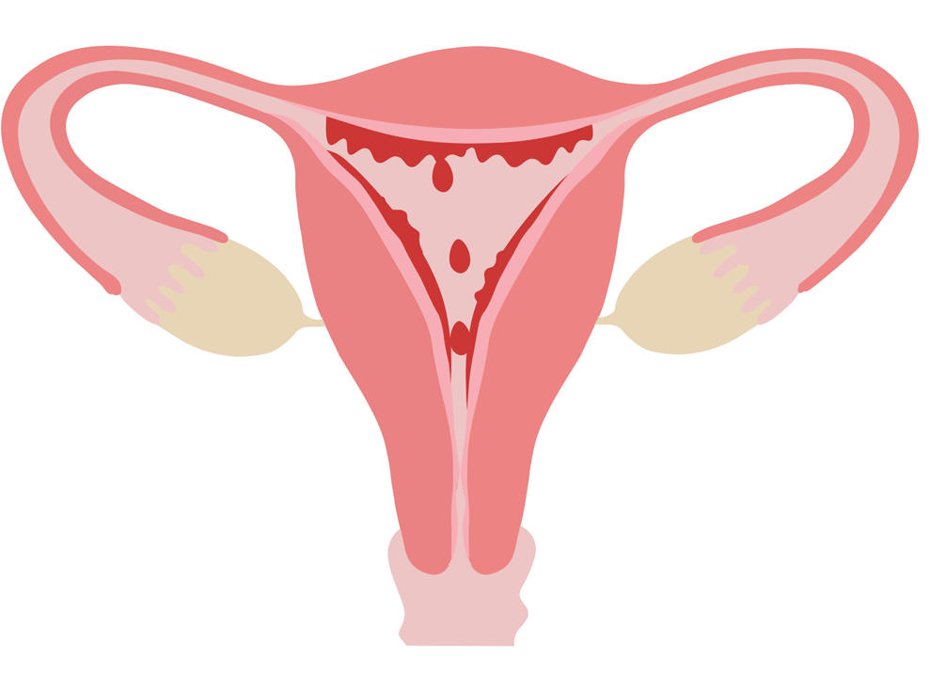
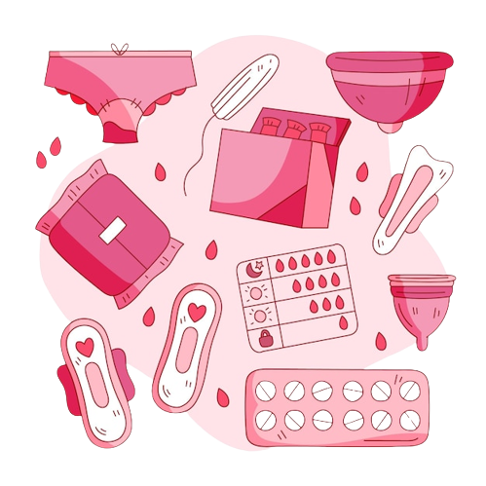
What are periods?
FALLOPIAN TUBE
UTERUS
When puberty is reached, an egg is released each month from the ovaries due to hormones changing in the body
The egg moves from the ovary, along the fallopian tube, and down into the uterus
If the egg is not fertilized by a sperm, the lining of the uterus & the egg leave the body through the vagina
OVARY
ENDOMETRIUM
CERVIX
VAGINA
Notes:
Menstruation is the time between puberty and menopause when the vagina bleeds each month
This happens because the endometrium prepares for pregnancy
When pregnancy does not occur (fertilization of an egg), the uterine lining sheds
This is a period?
This is menstruation or what we call a “period”

Slide 3
When does it start?
Typically occurs around 2 years after first signs of puberty, though may happen later or earlier
Remember everyone's body is different!
You can start your first period as early as 9 or later on at 15
First period: note any changes to body, bloating, acne and cramps

Slide 4
What to expect?
Acne/
pimples
Spotting
Stomach cramps
Tiredness
Headaches
Food cravings
Tender breasts
Mood swings
Feeling bloated

Slide 5
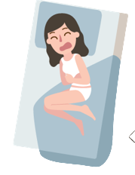
Other Common symptoms
Before and during cycle
everyone is different, everyone’s experience is different!
Bloating
Cramps
Fatigue
Acne flare
Back pain
fatigue
Irritability
Tender breast
Headache
Anxiety
Bleeding
Nausea

Slide 6
Menstruation Products available:
Pads
Tampon
Cup
Placed onto underwear & absorbs blood externally
Inserted into the vagina & absorbs blood internally
Cup-like product inserted into the vagina to collect menstrual blood

Slide 7
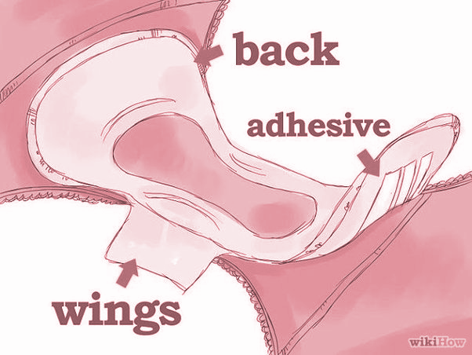
How to use Pads:
Steps:
Sanitize hands
Get a pad and remove the wrapper
Place the sticky side onto the center of the underwear
Flap and press the wings on back side of the panty
Pull up panty & wear as you normally do
Types:
Come in different sizes varies & from blood flow
Pantyliners, regular, or heavy
May be disposable or non-disposable
Make sure to change pads every 2 - 4 hours or when heavily saturated!
How to Dispose:
Roll pad and wrap toilet paper
Dispose in the trash
Do not flush product in toilet!

Slide 8
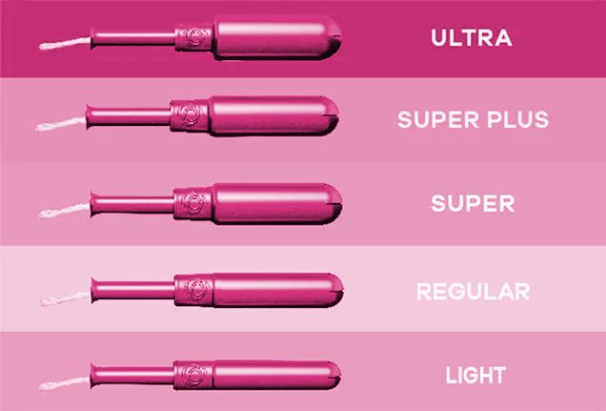
How to Use Tampons:
Steps:
Wash hands & get into a comfortable position
You can squat, put one leg up or sit in the toilet with your knees apart
Push tampon into vagina using the applicator or finger at a 45-90 ° angle
Throw the wrapper & applicator in the trash
Remember to change every 4 hours, do not leave in for over 8 hrs
How to Dispose:
Pull string-end that hangs out of the vagina gently
Wrap used tampon in toilet paper and throw away in trash
Don’t flush in toilet!
Types:
Tampons come in different size depending on blood flow
Some tampons have applicators
Notes:
Tampons can be used for swimming

Slide 9
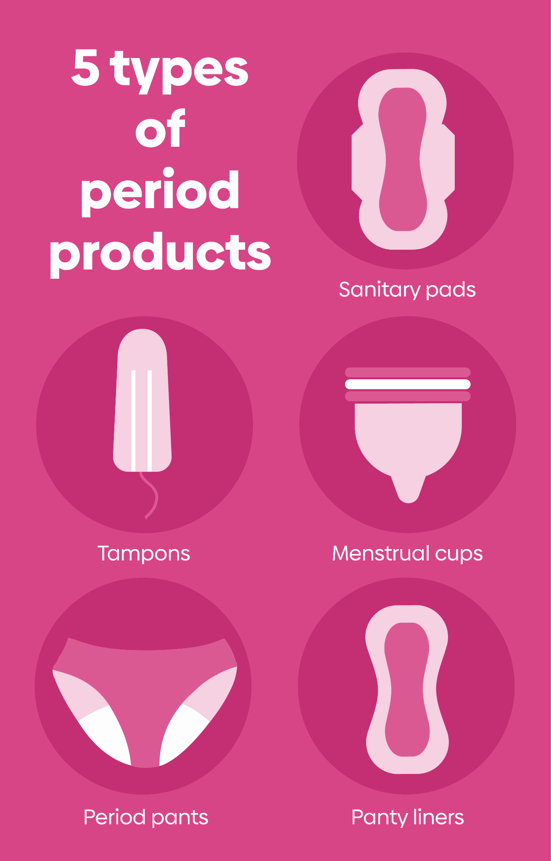
Other products available:
Notes:
Period Underwear:
Similar to regular underwear, but with an absorbent layer to prevent blood from getting onto clothing
Can be washed in a washing machine
More sustainable option
Menstrual Cups:
Small cup made of latex or silicone
You insert, you simply squeeze the cup and insert it into the vagina with the point facing down
Change once its full
Once removed, empty out the blood from cup into the toilet & rinse/wash cup thoroughly & re-use as necessary
One cup can last years, if taken care of properly

Slide 10
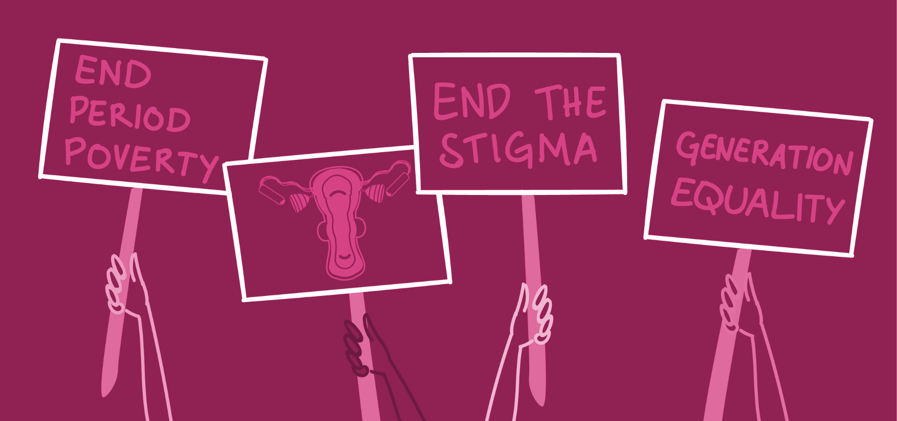
Remember menstruation is a perfectly natural, healthy bodily function!
Notes:
Typical cycle lasts around 28 days, while menstruation lasts anywhere from 3 - 8 days
Everyone’s body is different, teenagers often experience irregular cycles that should be discussed with your doctor if it occurs
Although it is common to expect some irregularities when you first begin experiencing your cycle

Slide 11
Hygiene tips
Washing hands
Wash your hands before and after using the bathroom and using menstrual product
Changing sanitary products
Change pads every few 2 - 4 hours
Change tampons every 4 - 8 hours
Keeping genital area clean
Can prevent infection, improves hygiene, and prevents odor
Drinking enough liquids
Helps to stay hydrated

Slide 12
Keeping Track of Your Cycle
Notes:
1
2
3
4
5
6
7
You can use a calendar or a notebook to keep track of period cycle
You can keep track of the date, duration and symptoms
This can help to determine any significant changes and monitor blood flow
Apps → FLO, my calendar, always you
8
9
10
11
12
13
14
15
16
17
18
19
20
21
22
23
24
25
26
27
28
29
30
31

Slide 13
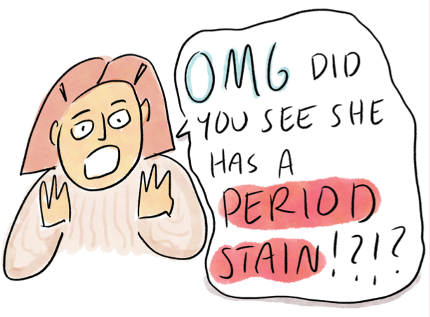
Stigmas about periods
What are period stigmas?
Negative views/myths about periods
Caused by false information
Myths that you may have heard:
Period blood is dirty blood
Periods are shameful
Being told that you are overreacting to period pain
Being in a bad mood must mean you're on your period
You shouldn't let anyone know
How does this make people feel?
Embarrassed
Ashamed
Uncomfortable, awkward
Shy
Notes:
https://www.healthline.com/health/womens-health/period-myths#Myth-3:-Its-OK-to-dismiss-our-feelings-when-were-on-our-period
That everything period related is “gross”
Being told that you are overreacting to period pain
Being embarrassed to buy period products at stores because it's supposed to be a secret

Slide 14
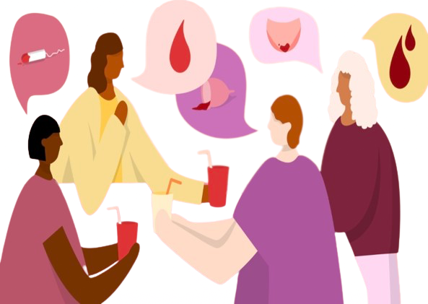
Stigmas about periods (cont.)
People may view periods as “gross” causing us to:
Hide period products in our sleeves, pockets, makeup bags
Being ashamed to carry products
Quietly opening products in public
Being embarrassed & scared to openly talk about periods
Notes:
Some families/children have certain taboos/myths in their cultural background
“Have you ever heard that it’s bad to walk on your feet” with no socks on your period
“It’s bad to cut your hair while on your period because it damages your hair health”
Marketing strategies
Appealing to the viewers through the idea of secreact and products being more discrete

Slide 15
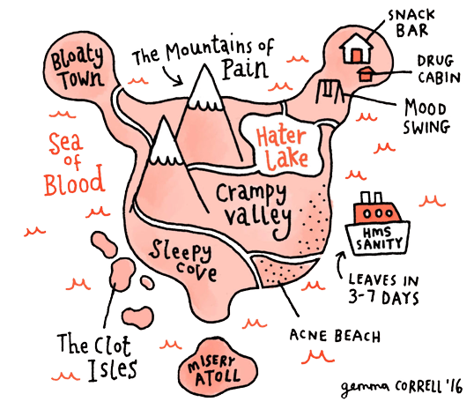
Different “Period” Names
“Bloody Mary”
“Auntie Flo”
“Code Red”
“My Best Friend”
“Girl Flu”
“The Red Sea”
“That Time of the Month”
“Lady Time”

Slide 16
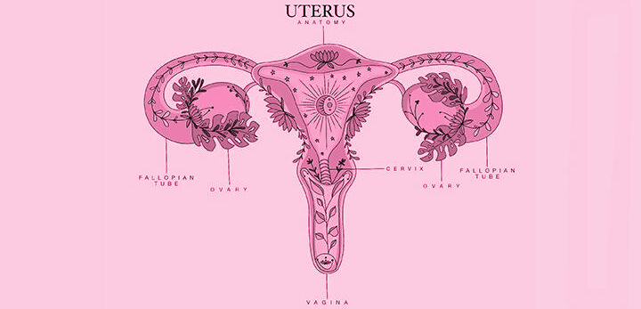
Embracing Period Talk
Menstruation is natural, normal, & healthy!!
That is why we should not be afraid, uncomfortable, or even embarrassed to call it by its proper name
The more openly that we talk about menstruation → more menstruators can see that they are not alone in their experiences → increasing the chances & opportunity of receiving proper menstruation education & care to manage their periods without feeling shame

Slide 17
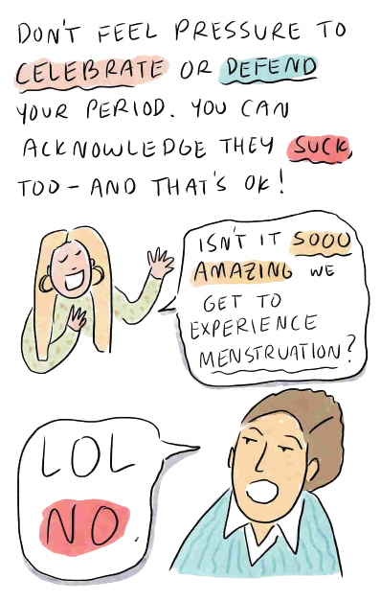
We are taught to…
Hide our period products
Toughen up (in terms of symptoms)
Not speak about it publicly
To not say “period” or “menstruation” outloud

Slide 18
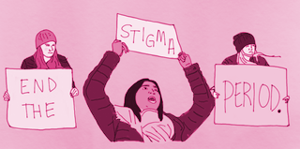
Why do we feel this way?
Because:
Period jokes
Our feeling/emotions are brushed off
Placed in an uncomfortable situations
Gender stereotypes
Lack of education
Ways to overcoming stigma:
Open communication about periods
Ensuring a safe environment
Advocate for access to products
Understanding menstruation is a naturally occurring bodily function

Slide 19
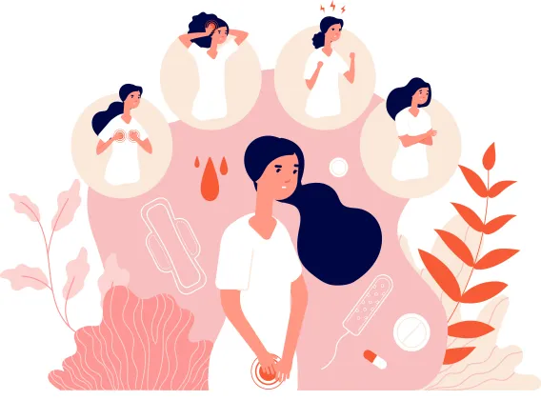
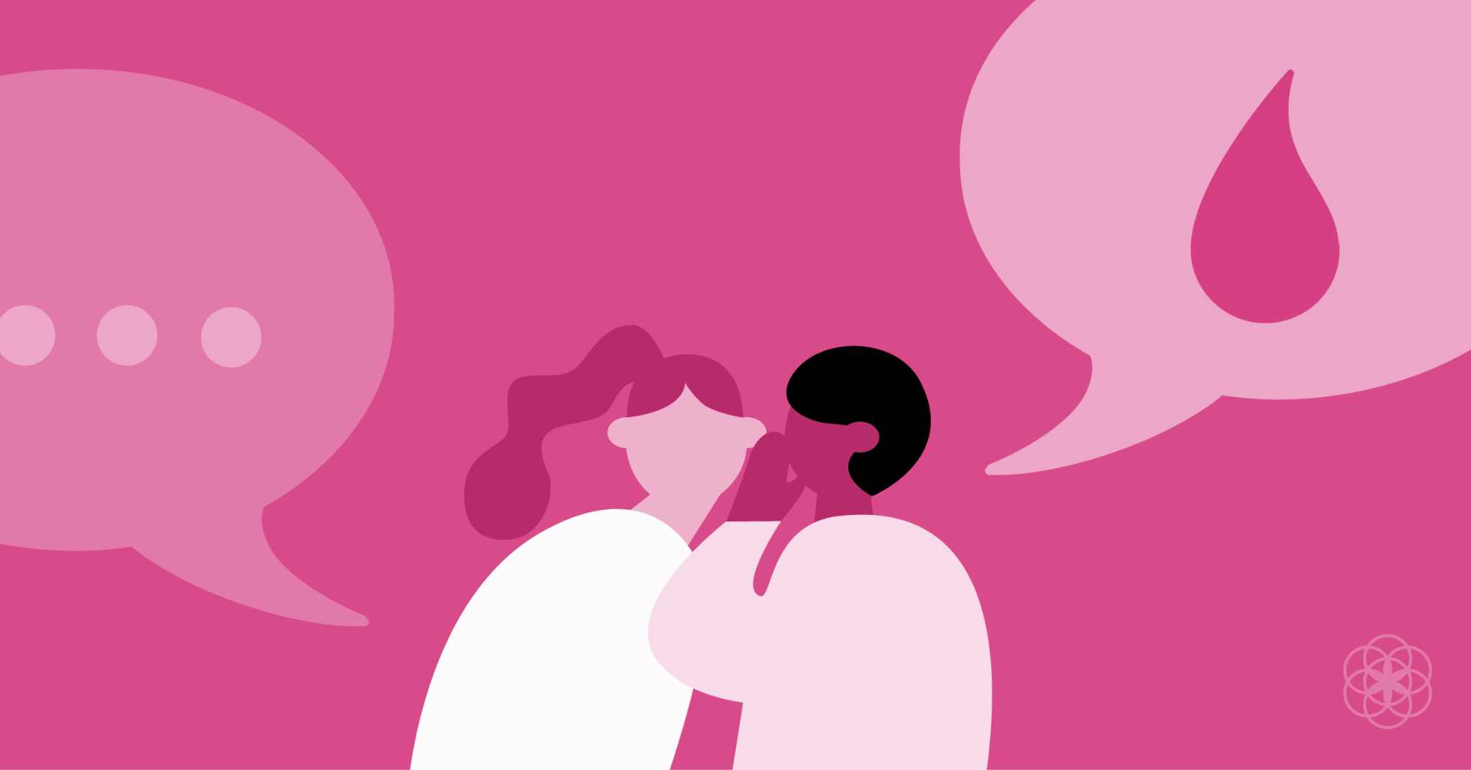
The influence of Culture and Religion
Impacts how periods are talked about & handled
May influence thoughts, knowledge & what education they receive about periods
How do we include culture & religion?
Ensuring a positive & friendly environment
Opening a conversation for others to talk about periods in the community
Being open minded
Being an active listener
Notes:
→ that is why we shouldn't judge someone for what they know or don't know about periods

Slide 20
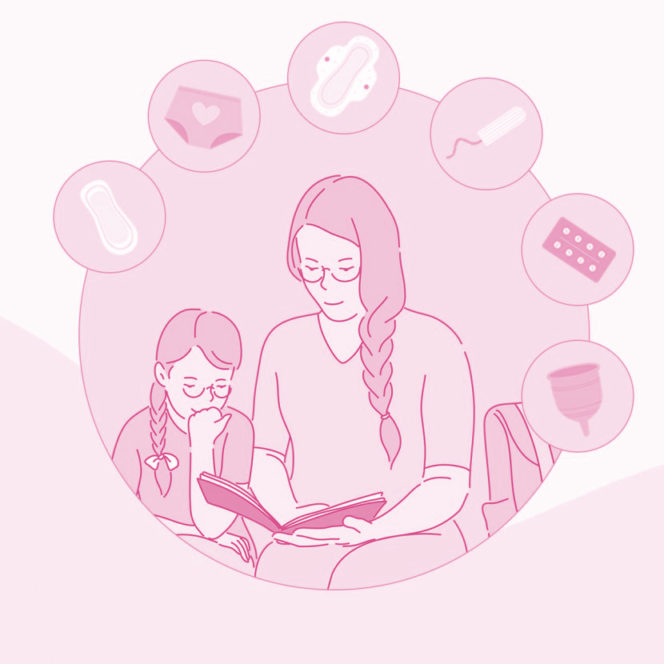
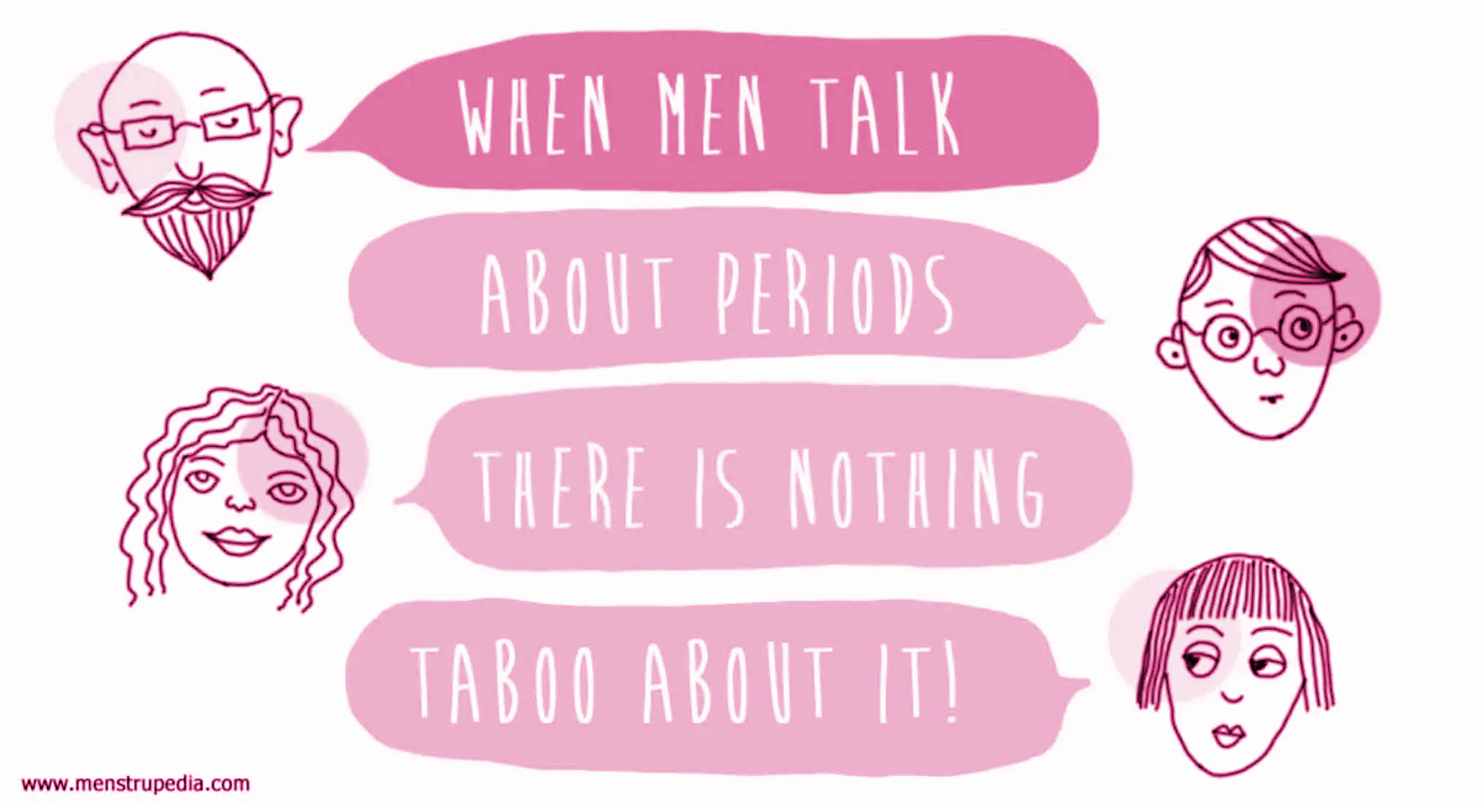
The Need for Open Communication
Allows new menstruators to feel informed & prepared
Reduce stress or anxiety
Decrease the feeling of awkwardness/embarrassment
Increasing confidence to talk about menstruation
Health consequences
Financial need → resources for assistance
Proper care
Confidence in own body
Manage physical & emotional symptoms
Cultural and religion
Notes:
It is about time we try and break the stigma around it. We need to create an environment where girls can access information and ask questions without shame, embarrassment and without judgment.

Slide 21
What is Period Poverty?
Period poverty
Limited access to menstrual products/menstrual health education due to financial difficulties or negative stigmas associated with menstruation
What can we do to improve period poverty?
Teach how to get access to products
Donate menstrual products
Raising awareness on this topic
Ending taboos & stigmas
Notes:
stigma, poverty, and lack of access to products are foundational elements that define period poverty today in the US
Almost a quarter of teens (and one-third of adults) struggle to afford period products
Populations at risk include Black and Latina community

Slide 22
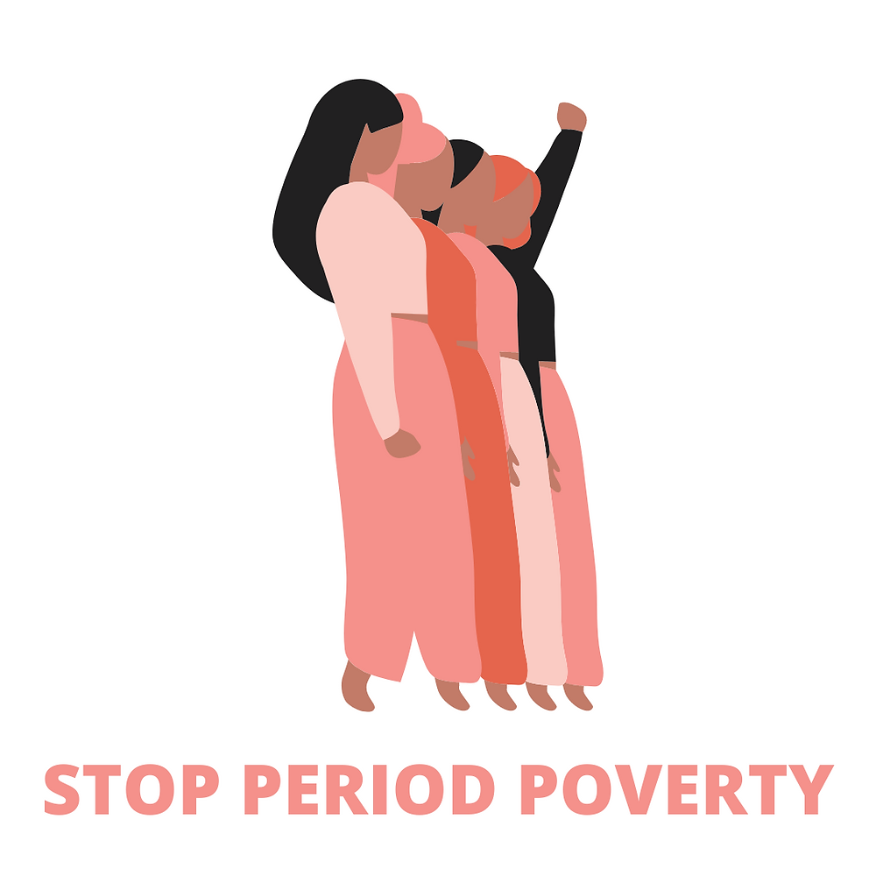
Why we need a solution?
Lack of access to products lead to using period products longer than recommended
Can lead to
Risk of toxic shock syndrome
Cervical cancer
Dangerous infections
Difficulty affording products lead people to using unsafe alternatives:
Socks
Dishrags/toilet paper
Newspapers
Notes:
Health consequences, academic consequences, continued financial insecurity

Slide 23
Why we need a solution? (cont.)
Lack of products affect potential to succeed:
Leaving school early or miss school entirely
Buying a box of period products can place financial burden on families
May lead to students to missing school or adults missing work
Reinforcing poverty

Slide 24
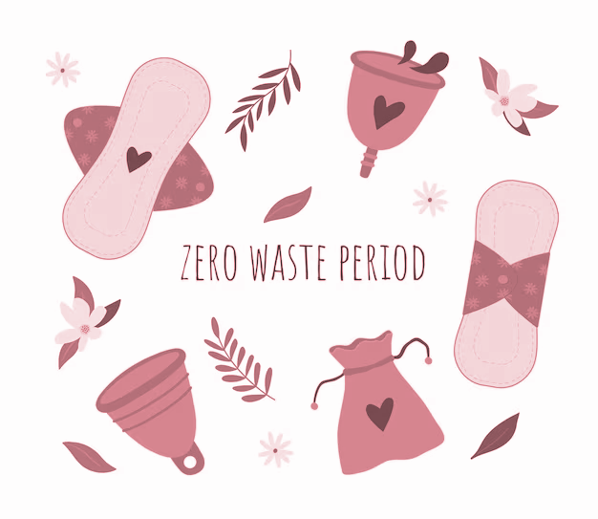
Respecting Menstrual Products Provided
How to prevent wasting products:
Educating on the importance of getting free access to products
Increase discipline
Understanding others may depend on resources provided
Why is it important?
There’s already a lack of resources & individuals who have difficulty purchasing products, making it unfair for those who need products
Increases menstrual stigma
Increases period poverty

Slide 25
Menstrual Equity
Why it matters:
It helps address/end stigmas, learn about different products, get access to resources, & receive quality education about periods
Risk Factors:
Low income
Lack of education
Lack of resources
What is it?
Refers to having equal access to menstrual hygiene products & the right to education about periods/women’s health
Notes:
Aiming for menstrual equity will allow menstruators the products and information they need to manage their period effectively, without shame or embarrassment, which is something that everyone deserves*******

Slide 26
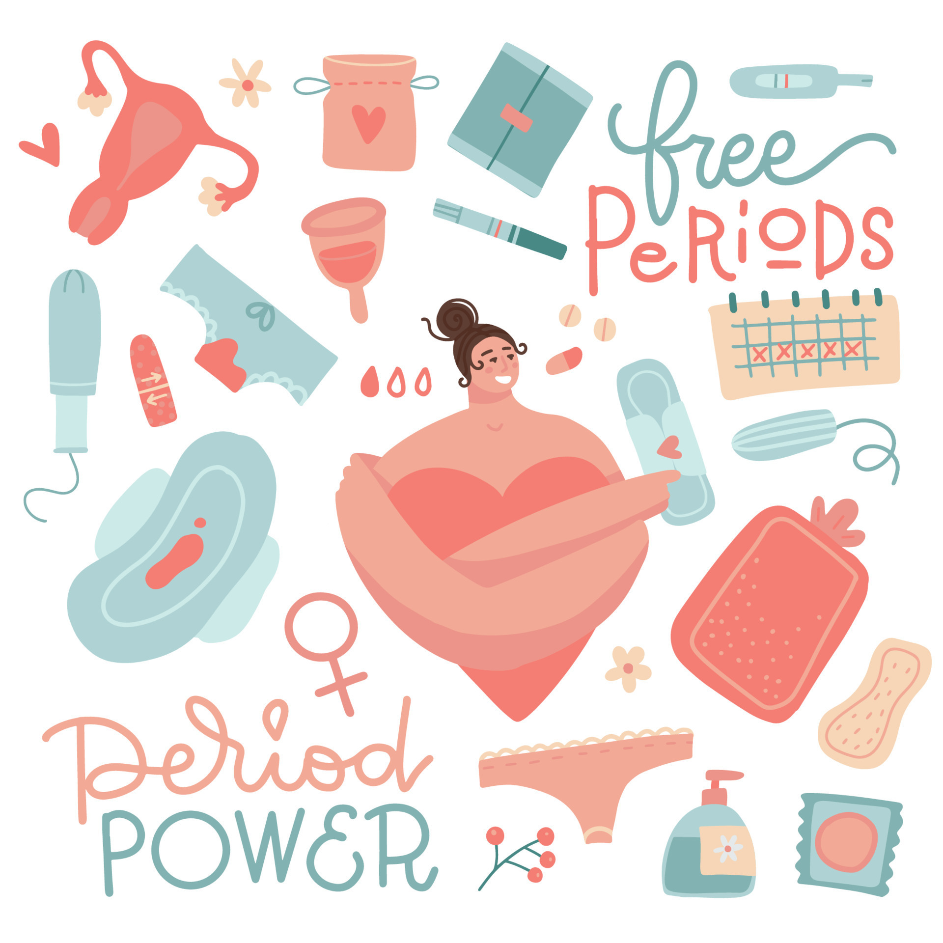
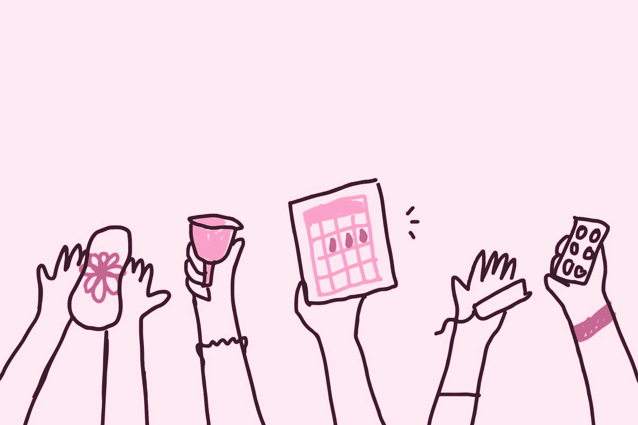
Any questions?

